Slide 1
Privacy Preserving Machine Learning
Under supervision of Dr.Malay kumar

Slide 2
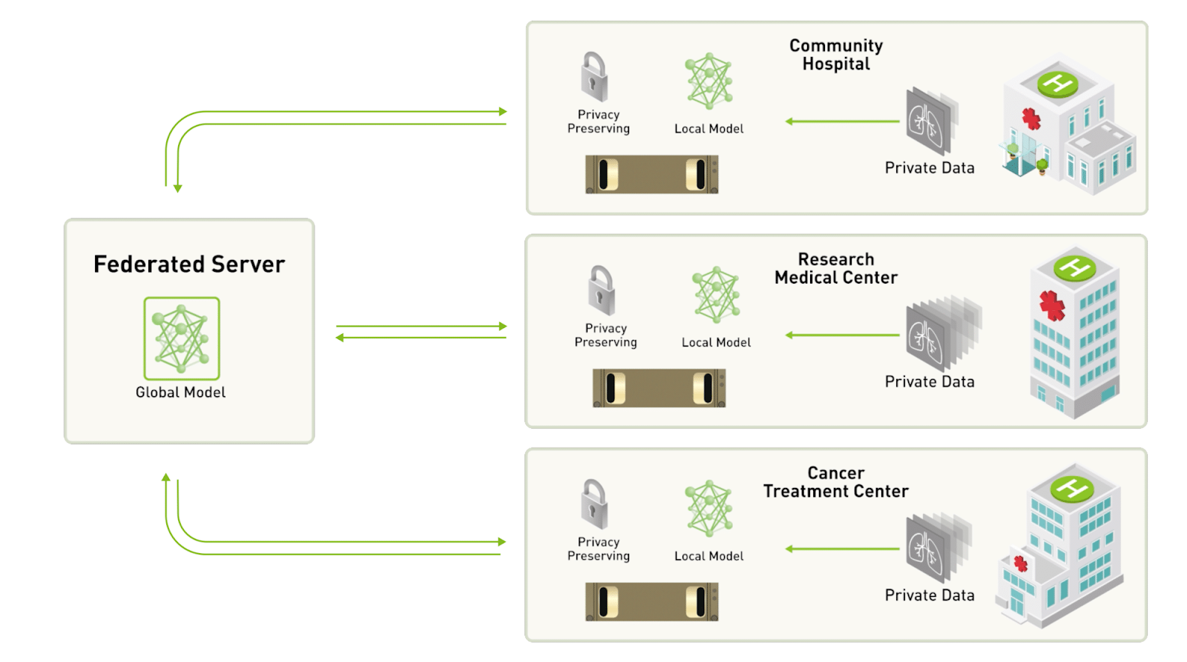
Problem Statement
We will try to solve breast cancer detection by securely accessing data from hospitals using federated learning because it is very difficult to access private medical data from hospitals.
A comparison of traditional machine learning and federated learning will also be made.

Slide 4
CONTENTS
Motivation
Related Work
Approach
Results

Slide 5
How machine learning was done in the past?
A datacenter with a large dataset of required data is typically benchmarked and trained on a large server with a powerful GPU, after which a machine learning model is built and used in production.
However, if private data is required, this type of machine learning approach fails.
Governments do not allow businesses to do so.
However, gaining access to that data can help solve problems at a large scale.

Slide 6
So how to solve this?
This is where the concept of federated learning comes into play.
The data in federated learning never leaves the device.
The model is trained locally on that device before being encryptedly sent to a central server.
The models from all of the devices are then combined to create a global model on the central server.

Slide 7
MOTIVATION
Constraints
Data should not leave a hospital, even in the encrypted format.
Origin of data should not be inferred at any time.
Each party is “honest but curious”

Slide 8
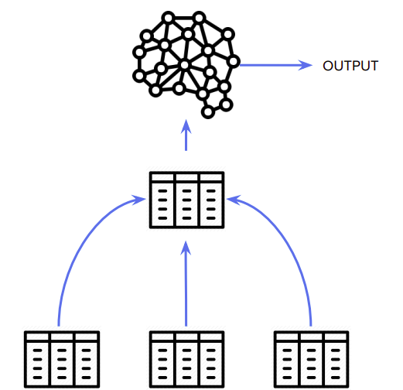

Slide 9
RELATED WORK

Slide 10
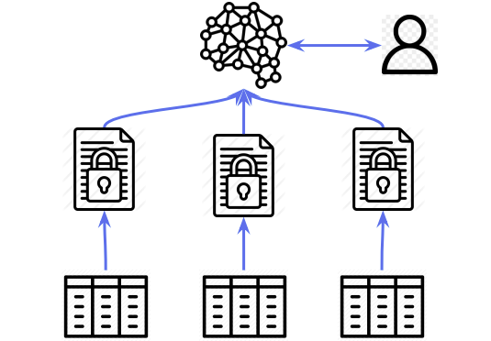

Slide 11
Secure Model Fusion for Distributed Learning Using Partial Homomorphic Encryption
Each client computes individual weights
Sends encrypted weights to server
Server sums them up and sends to leader client
Client decrypts it and sends it to all clients

Slide 12
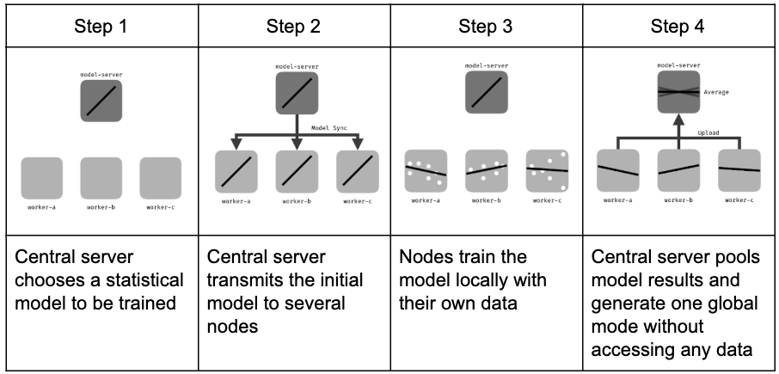

Slide 13
APPROACH

Slide 14
APPROACH: DATA
Use the breast_cancer dataset from scikit-learn
The hospitals will have different patient records but with the same feature set.
Data split into test and train set in 1:3 ratio.
This train set is further split into n shares for n hospitals.
The test set is common for all parties and for all experiments.

Slide 15
APPROACH: MODEL
Use Logistic Regression Classification model for classifying breast cancer into benign or malignant.
Federated learning on the complete data of all the n hospitals.
Our approach is to not share data in its true or encrypted format
Instead share the derived information i.e. gradients in the encrypted format.
The company X creates the public-private key pair using Paillier scheme (PHE).
Public key is shared with the hospitals for the gradient encryption
Private key is kept with the company itself.

Slide 16
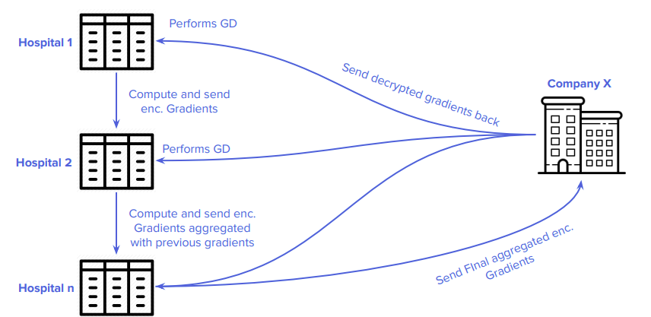
Approach: Training

Slide 17
Approach: Training
for hospital hi in n do
gi ← compute gradient for hi on data Xi
agi ← gi + agi − 1 where aggregated gradient agi − 1 from hi−1
end for
dag ← Company decrypts ag
for hospital hi in n do
hi performs gradient descent using dag
end for

Slide 18
Approach: Security
We consider all parties to be honest but curious.
No hospital will be able to point out where patients’ data originated.
True if the protocol is run by at least 3 hospitals preventing the reconstruction of each others’ gradients.
The company X cannot learn anything about the underlying data from the total aggregated gradient, thereby preserving patients' privacy.
Centralized aggregation vs coupled: O(1) vs O(logn) aggregation. Security issue in O(1) since Server can pinpoint patients’ data origins.

Slide 19
Results- Breast Cancer
Number of hospitals (n) | Avg Acc (LL) (in %) | Train Time (LL) (in s) | Avg Acc (FL) (in %) | Train Time (FL) (in s) | Avg Acc (sklearn) (in %) | Train Time (sklearn) (in s)
3 | 96.27 | 0.003 | 95.80 | 2.821 | 95.80 | 0.123
7 | 96.00 | 0.006 | 95.80 | 6.315 | 95.80 | 0.028
10 | 95.38 | 0.008 | 95.80 | 9.987 | 95.80 | 0.033
20 | 94.93 | 0.161 | 95.80 | 18.343 | 95.80 | 0.036
27 | 94.17 | 0.209 | 95.80 | 24.681 | 95.80 | 0.038

Slide 20
Results - grad admission
Number of Data Owners (n) | Avg Acc (LL) (in %) | Train Time (LL) (in s) | Avg Acc (FL) (in %) | Train Time (FL) (in s) | Avg Acc (sklearn) (in %) | Train Time (sklearn) (in s)
3 | 70.40 | 0.003 | 86.40 | 0.777 | 86.40 | 0.024
7 | 80.46 | 0.006 | 86.40 | 1.709 | 86.40 | 0.029
10 | 79.28 | 0.014 | 86.40 | 2.594 | 86.40 | 0.027
20 | 75.24 | 0.017 | 86.40 | 5.143 | 86.40 | 0.030
27 | 77.16 | 0.020 | 86.40 | 6.802 | 86.40 | 0.024

Slide 21
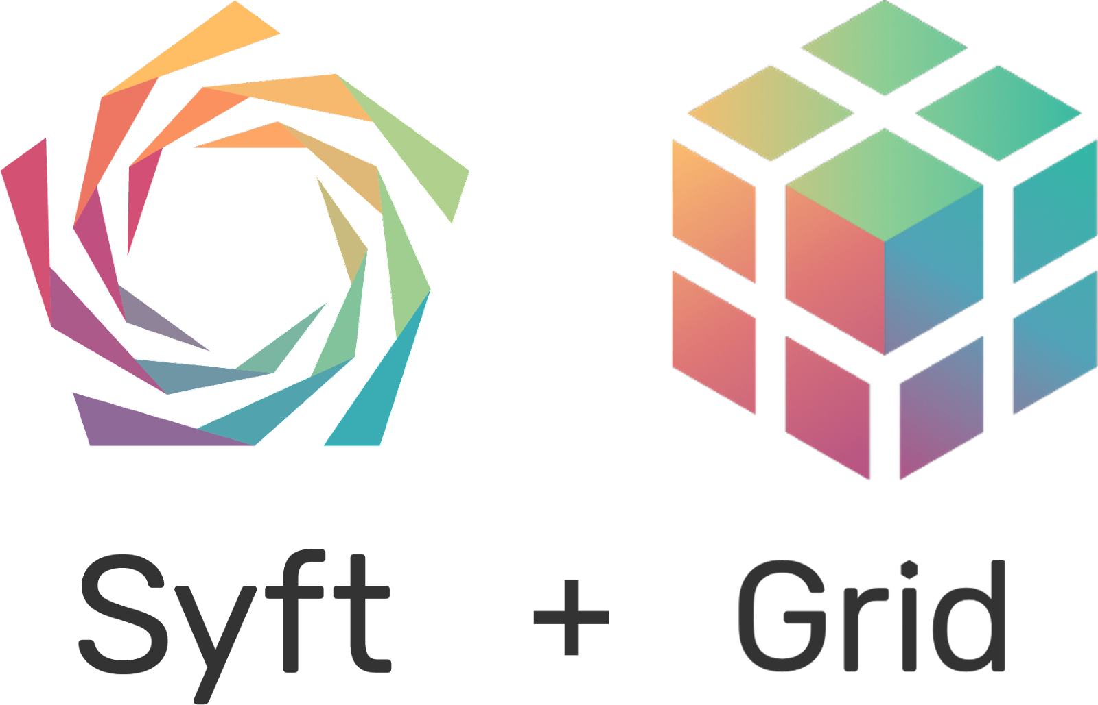


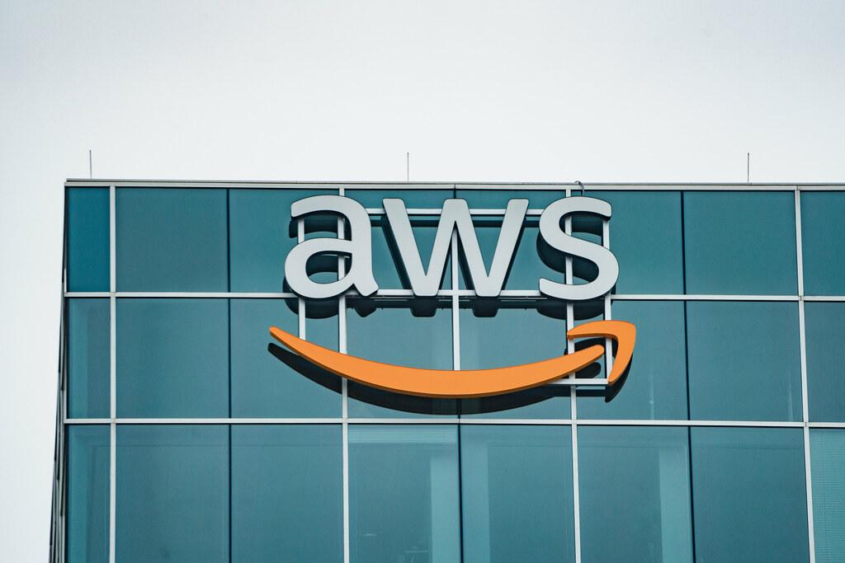
Tech Stack

Slide 22
